Slide 1
SOA

Slide 2


Slide 3
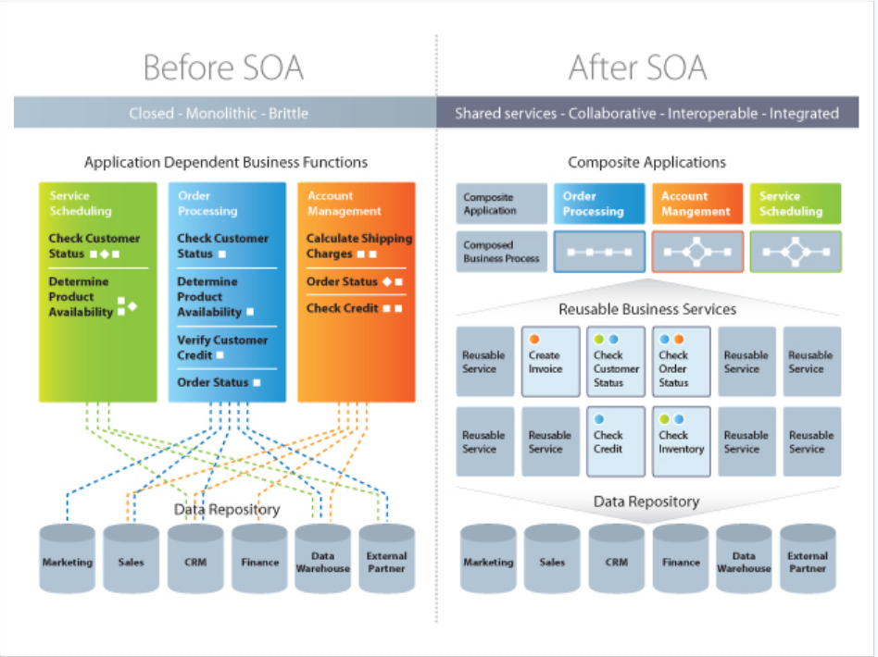

Slide 4
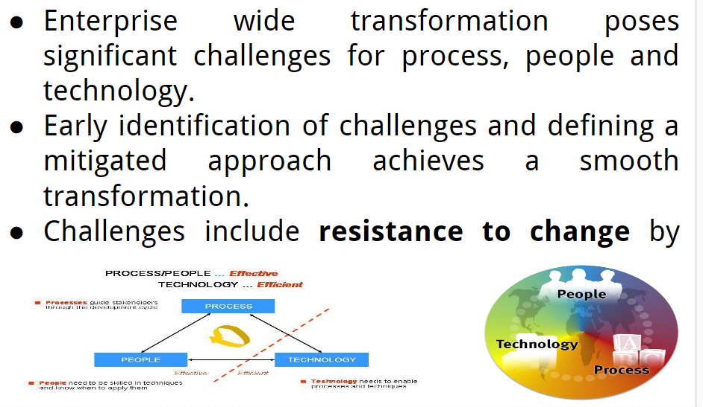
Introduction

Slide 5
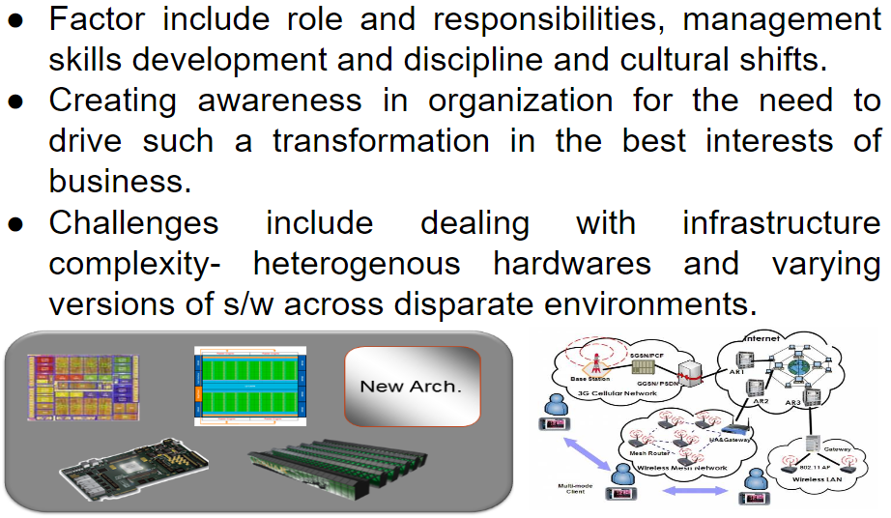
Introduction

Slide 6
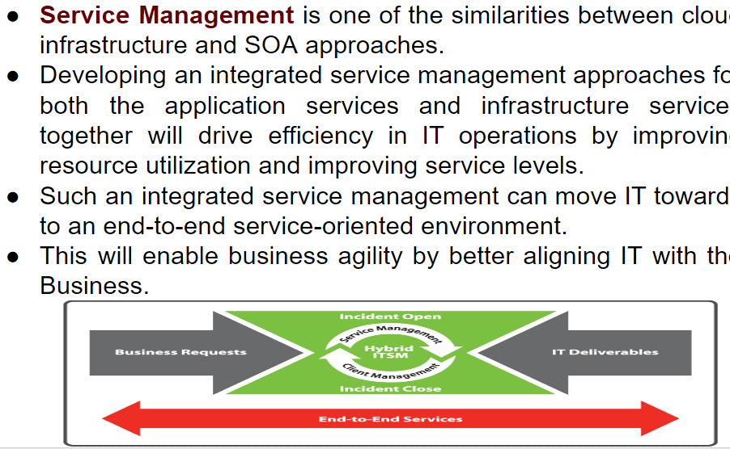
Service Management

Slide 7
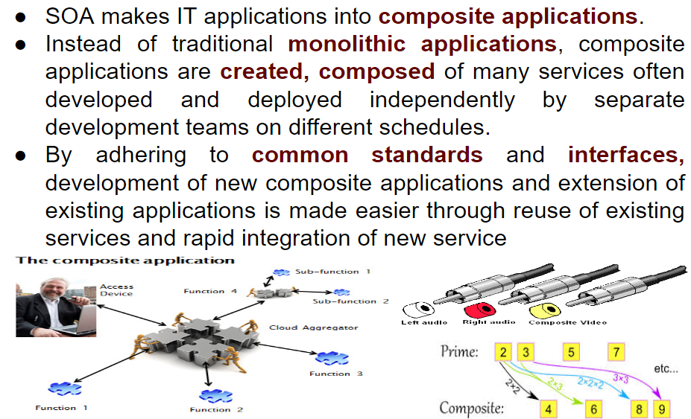
Enterprise Infrastructure and SOA

Slide 8
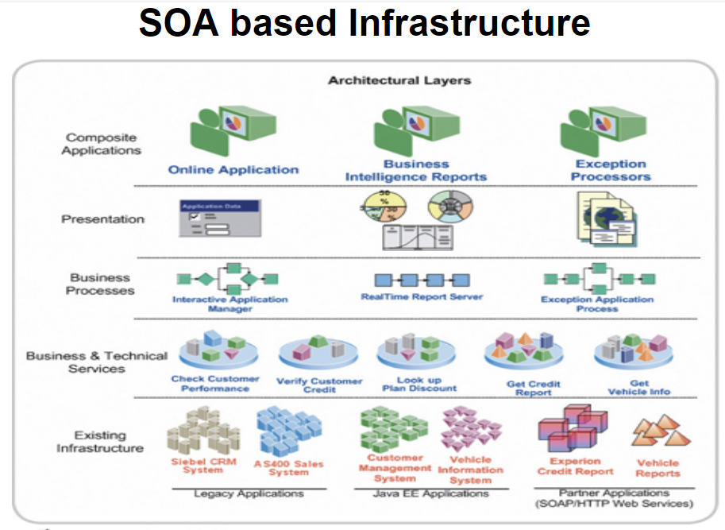

Slide 9
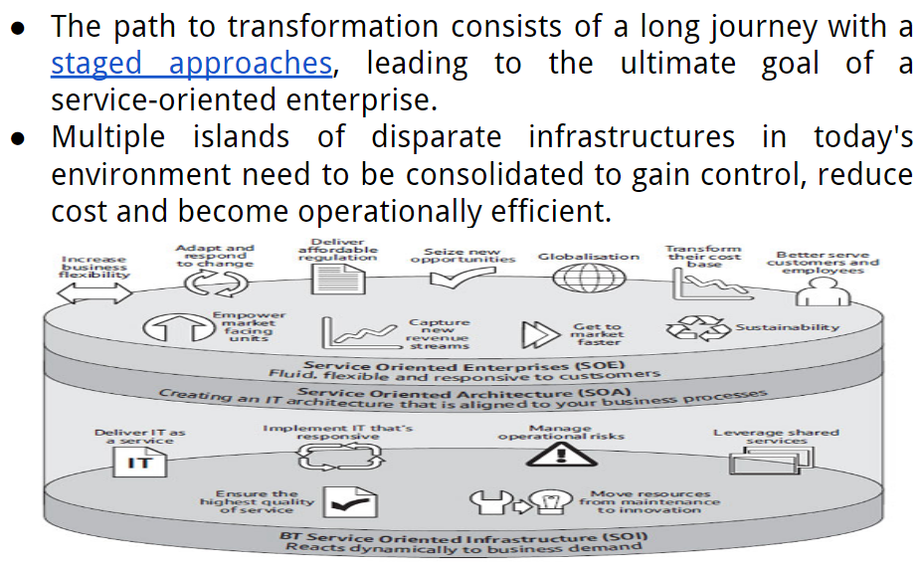
SOA journey to infrastructure

Slide 10
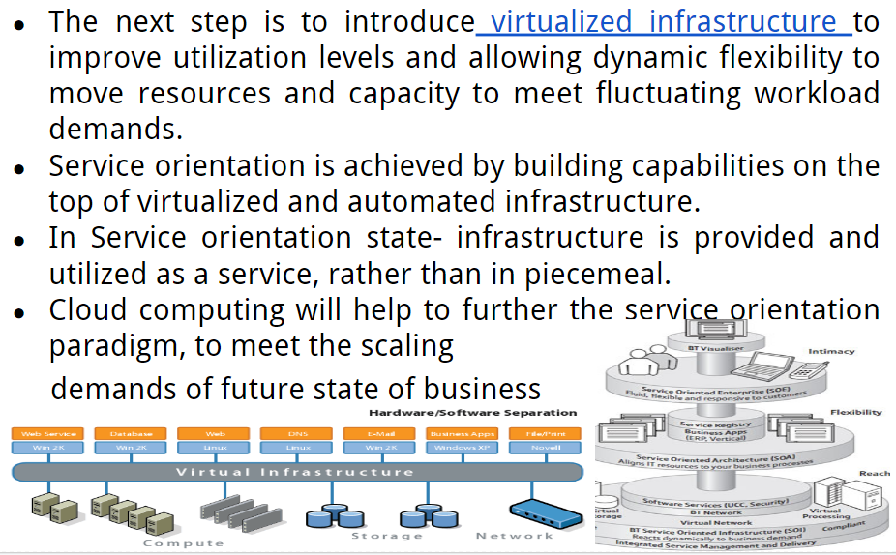
SOA journey to infrastructure

Slide 11
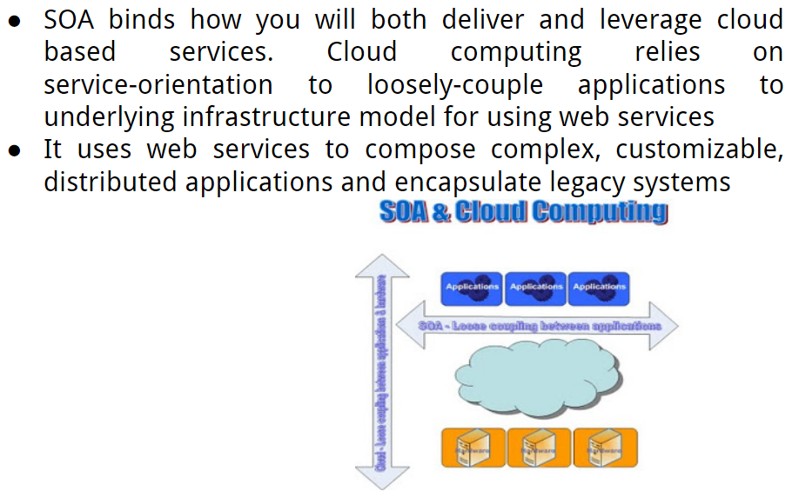
SOA and Cloud

Slide 12
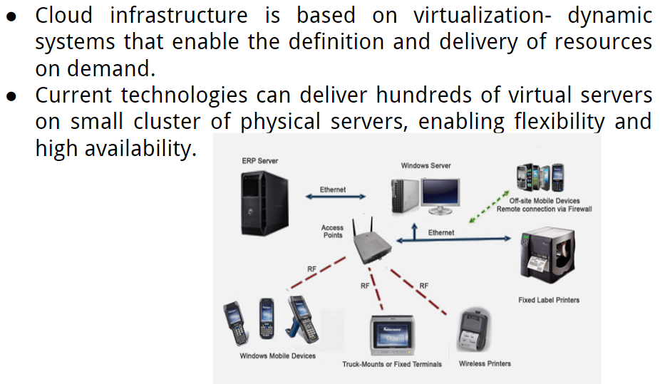
Infrastructure Technologies

Slide 13

SOA Defination

Slide 14
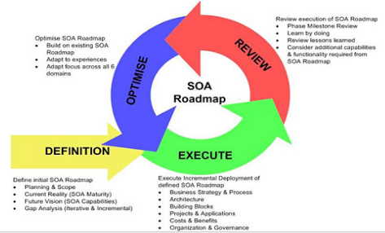

Slide 15
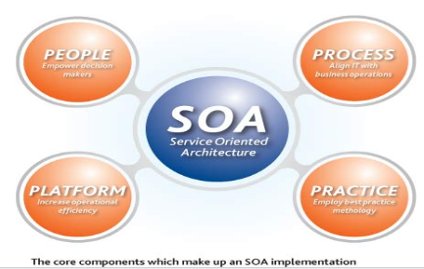

Slide 16
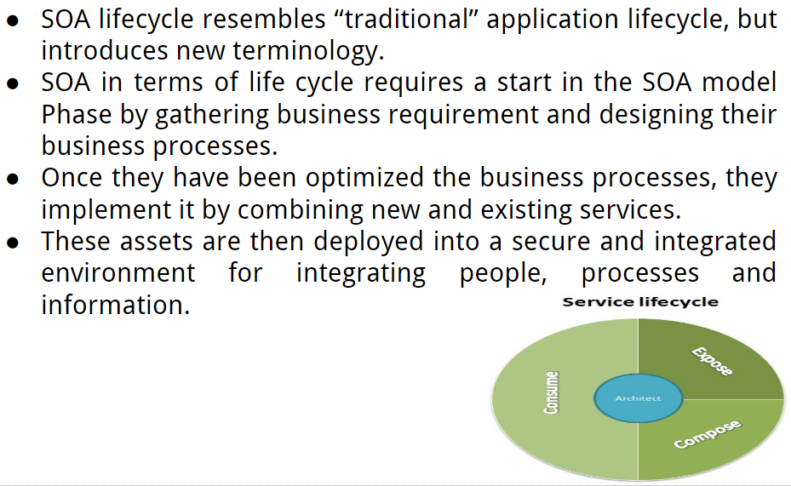
1.SOA Life Cycle

Slide 17

2.Service Oriented Computing

Slide 18
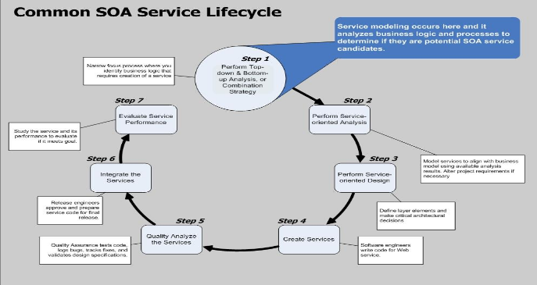

Slide 19
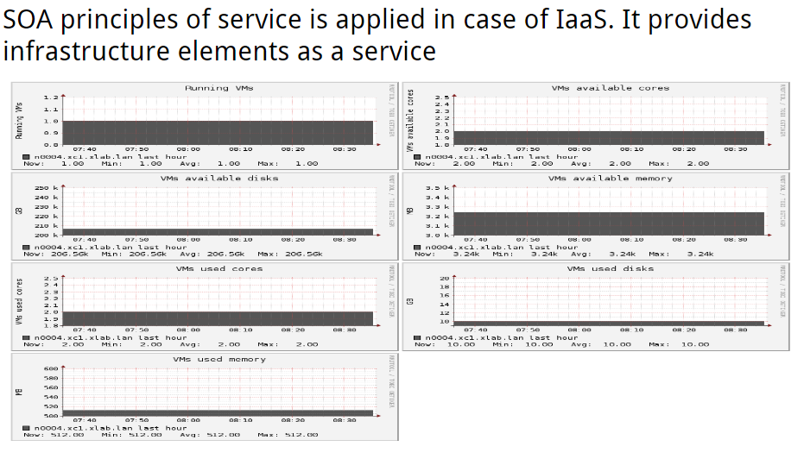
SOA and IaaS

Slide 20
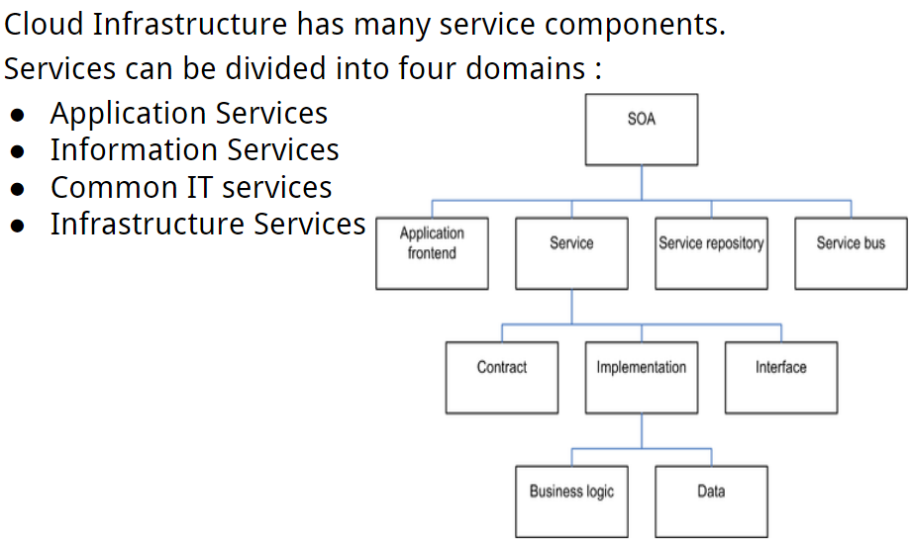
1. Architecture

Slide 21
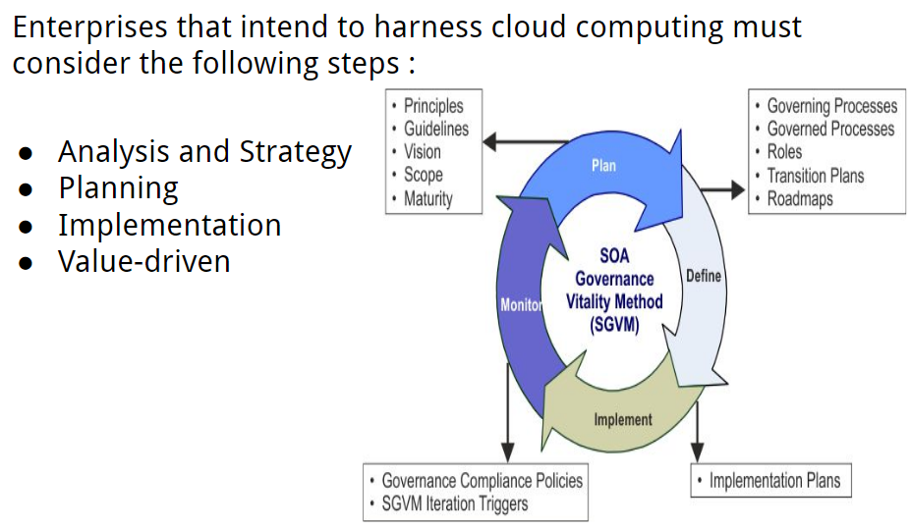
SOA based Cloud Infrastructure steps

Slide 22
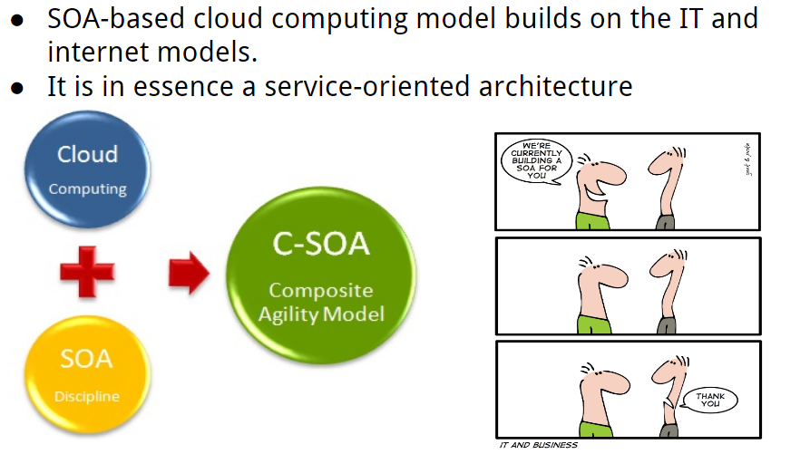
1. SOA and Cloud Infrasture

Slide 23

SOA Business and IT services

Slide 24
Thank you

